Slide 1
Hands on OFDM crash course
(Orthogonal Frequency-division Multiplexing:
standard modulation format for 5G New Radio)
"Preach the Gospel at all times. Use words if necessary.”
St. Francis of Assisi
"Talk is cheap. Show me the code " Linus Torvalds
“Simplicity is the ultimate sophistication.”
Leonardo da Vinci

Slide 2
Organization, Way of Work
You should always submit a full set of slides, regardless of the number of solved ones.
The name of the presentation file should look like this: Surname_First_NumerLastSolvedSlide, (do not use Polish letters), example "Zoladz_Miroslaw_50.pptx"

Slide 3
Organization, Materials content and modification
Most of the slides contain screenshots of the scripts to be completed.
Their text versions can be found in the appendix attached to the presentation.
The paths to the script files are given either directly on the slide or in the slide notes
Problem solutions should be placed directly in the presentation.
In the case of scripts, screenshots of their solutions should be placed ON the task scripts.
Screenshots should contain ONLY code and line numbers.
Please don't give console screenshots unless it is explicitly stated in the command.

Slide 4
Organization, Materials content and modification, cont.
In addition, please:
- do not remove/move any elements of the presentation, in particular slides,
- do not remove my comments from the code,
- don't comment out lines of code (either something is or isn't),
- don't use comprehension lists or maps, just plain for.
Please ask questions via chat or in a meeting, not on slides

Slide 5
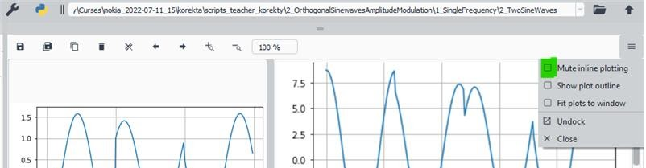
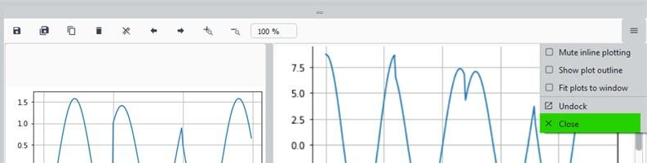
Python tool
Preferred environment : https://www.anaconda.com/products/distribution
(Other tools allowed but we do not support you in case of problems)
Preferred application: "Spider“ (from Anaconda)
Preferred settings: Prints and pot in the same window:
Uncheck "Mute..“
2) Close all panels in Console
Useful shortcuts
Console clear: Ctrl-l
Code block commenting\uncommenting : select blok, press “ctrl-1”

Slide 6
Course plan
2D vectors
Dot product formula
Orthogonal examples
Dot product vs. angle
Vector as a list of numbers
2D example
3D example
Dot product of vectors
Dot product of signals
Sum of periodical signals
Dot product of sinusoids
Sinewaves orthogonality
Orthogonal sinewaves amplitude modulation
Discrete Fourier Transformation
Vector as a signal - signal as a vector
Dot product of signals
Signal's similarity
Dot versus phase shift
Dot versus amplitudes
Interferences

Slide 7
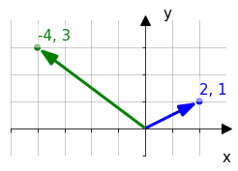
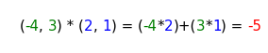
Dot product formula
Vector coordinates: b(blue) = (x, y); g(green) = (x, y)
Product formula: b*g = (x*x) + (y*y);
input: vectors,
output: scalar <- sum of multiplication of corresponding coordinates
g = (-4,3), b = (2, 1)
teacher\app_dot_2d_draw_and_calc.py

Slide 8
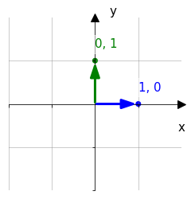
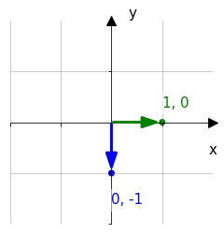
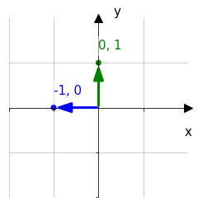
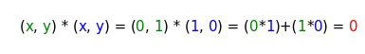
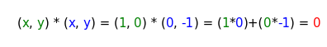
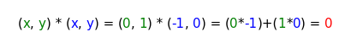
Dot Product: Orthogonal vectors examples
In all cases dot product equals to zero.
Maybe because one of the corresponding coordinates is always zero ?
0, 1
1, 0
1, 0
0,-1
0, 1
-1, 0
0, 0
0, 0
0, 0
teacher\app_dot_2d_draw_and_calc.py

Slide 9
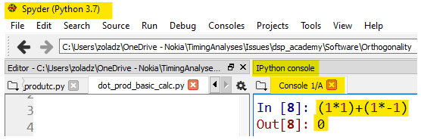
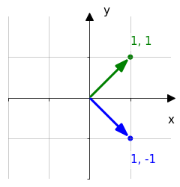
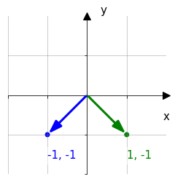
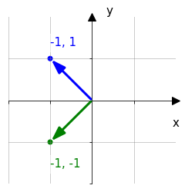
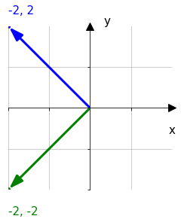
Dot Product: Orthogonal vectors examples: Nonzero coordinates
Calculate dot product of following vectors.
Use Spider REPL
REPL (stands from Read–Eval–Print Loop), A simple interactive computer programming environment
that takes single user inputs, executes them,
and returns the result to the user. [Wikipedia]
Calculations | (1*1)+(1*-1) | (-1*1)+(-1*-1) | (-1*-1)+(1*-1) | (-2*-2)+(2*-2)
result | 0 | 0 | 0 | 0
Still zero ? Maybe because we use the coordinates of the same absolute value (1 or 2)?
teacher\app_dot_2d_draw_and_calc.py

Slide 10
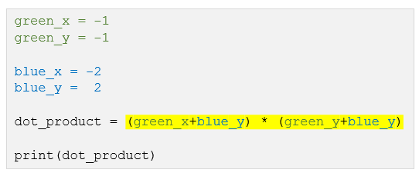
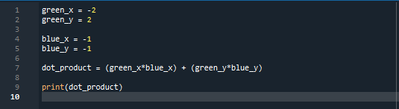
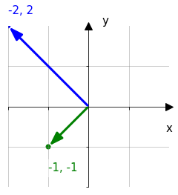
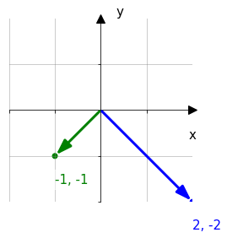
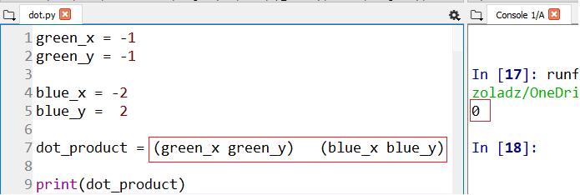
Dot Product: Orthogonal vectors examples: Nonzero coordinates, cont.
Calculate dot product of following vectors.
To work more efficiently instead of REPL use script on the right
Note: correct mistakes in dot product formula
Fix dot product formula
Run the script (F5)
Find result in console
(-2*-1)+(2*-1)=0 | -1*2+-1*-2=0
Still zero ? Maybe because we use the same absolute value of a single vector coordinates (1 or 2)?
Notes:
1_SinewavesOrthogonality\1_DotProductOfVectors\1_dot_calc_manual_crds_separate.py

Slide 11
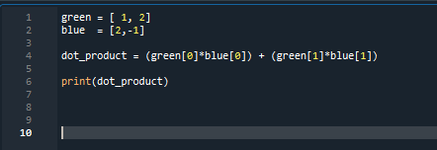
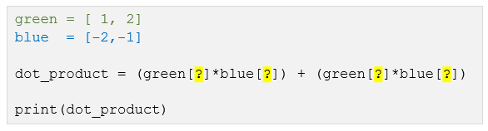
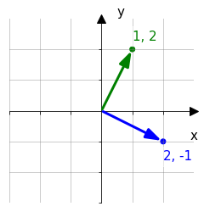
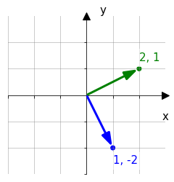
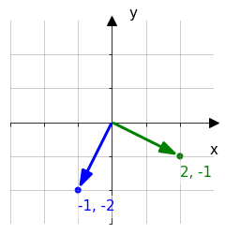
Dot Product: Orthogonal vectors examples: Nonzero coordinates, cont.
Calculate dot product of following vectors.
Use script with, more concise, vector coordinates notation (->).
(Use the same file)
1*2+2*-1=0 | 2*1+1*-2=0 | -1*2+-1*-2=0
Still zero ? Maybe because we use integer coordinates?
Notes:
11_SinewavesOrthogonality\1_DotProductOfVectors\2_dot_calc_crds_as_lists.py

Slide 12
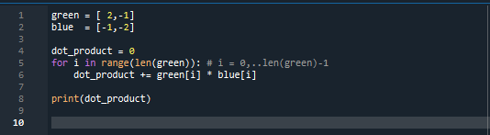
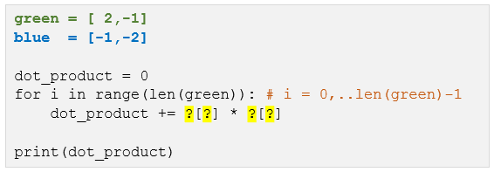
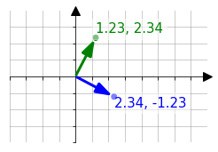
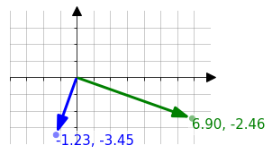
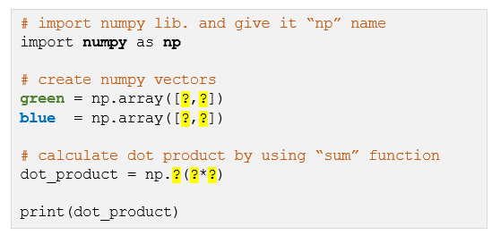
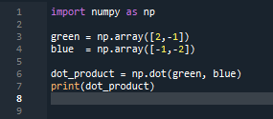
Dot Product: Orthogonal vectors examples: Nonzero coordinates, cont.
1. Calculate dot product of following vector configurations.
Use script version with “for” loop for iteration through vector indices. In this case these are 0 and 1.
This code works for vectors of any length.
1_SinewavesOrthogonality\1_DotProductOfVectors\3_dot_calc_loop_usage.py
2. Avoid loop-ing by using “sum” function from “numpy” library.
1.23*2.34+2.34*-1.23=0 | -1.23*6.9+-3.45*-2.46=0
1_SinewavesOrthogonality\1_DotProductOfVectors\3_dot_calc_sum_usage.py
Evidently dot product of any perpendicular vectors equals to zero. How about other angles ?

Slide 13
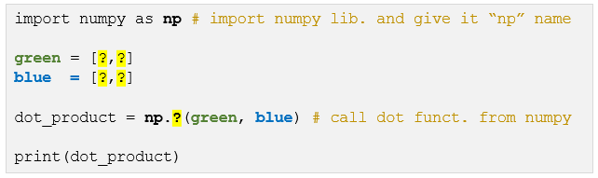
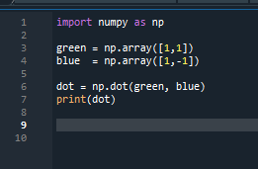
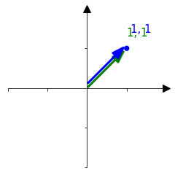
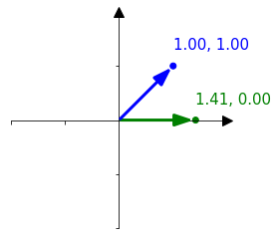
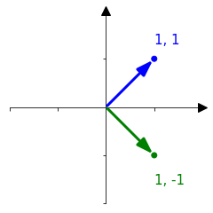
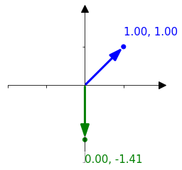
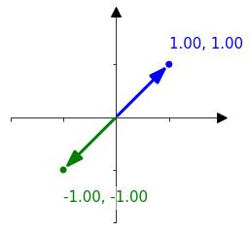
Dot Product: Non orthogonal vectors examples
Calculate dot product for the selected angles between vectors.
Take advantage of “dot” function from “numpy” library
dot product | 2 | 1.41 | 0 | -1.41 | -2
For which angle dot product has maximum value and for which a minimum value?
Put answer here: MAX FOR 0, MIN FOR 180
Notes:
1_SinewavesOrthogonality\1_DotProductOfVectors\4_dot_calc_np_function.py

Slide 14
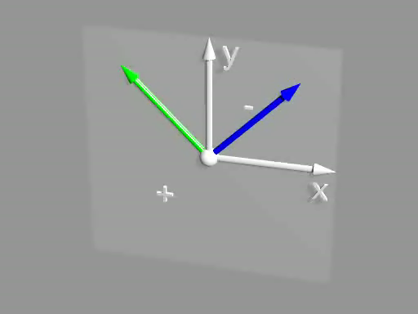
Dot Product: Non orthogonal vectors examples, cont.
Results from previous slide let us suppose that the dot product :
takes its maximum when the vectors points at same direction,
equals to zero when the vectors are orthogonal
takes its minimum when the vectors points at the opposite direction.
Click to play
2d_vect_dot.pov

Slide 15
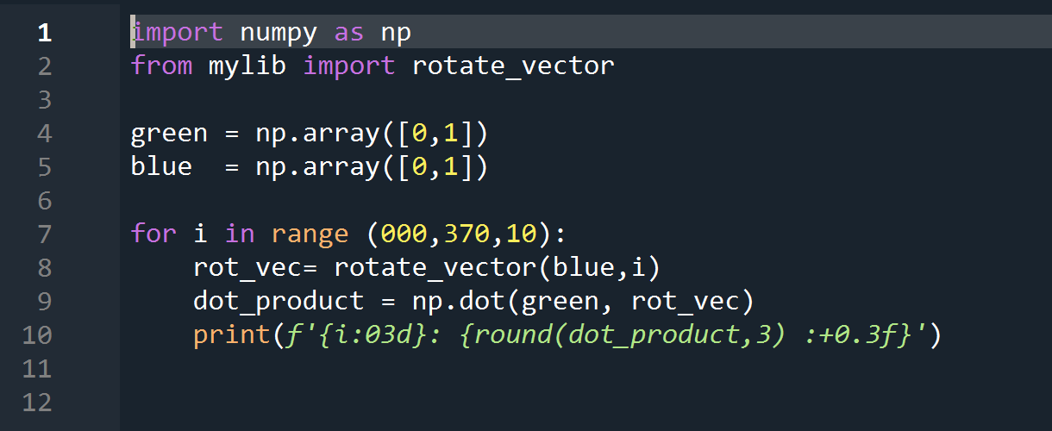
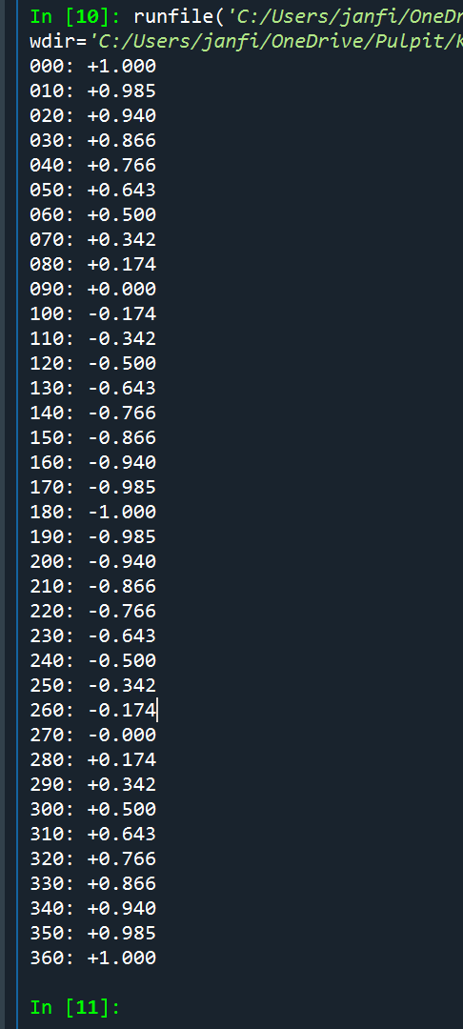
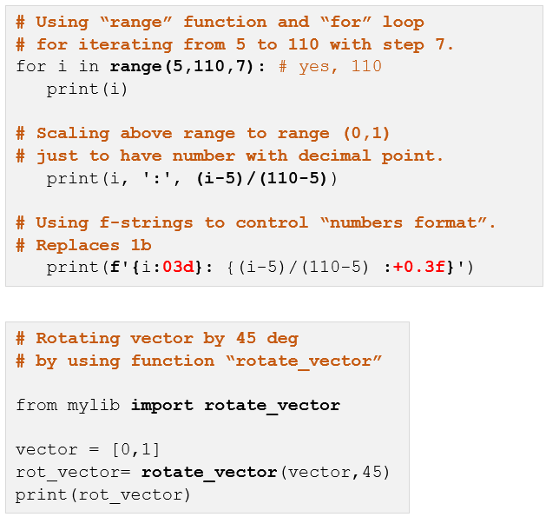
Dot Product v.s. vectors angle
Print dot product between green and blue vector for ${360}^{°}$ angle range with ${10}^{°}$ steps.
Assume that green vector is fixed at [0,1] and blue vector rotates.
Auxiliary examples (not solution for task)
Expected result
code
console
000: +1.000
010: +0.985
020: +0.940
...
360: +1.000
Notes:
1_SinewavesOrthogonality\1_DotProductOfVectors\5_dot_calc_angle_range_print.py

Slide 16
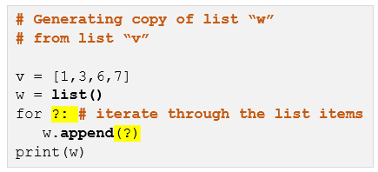
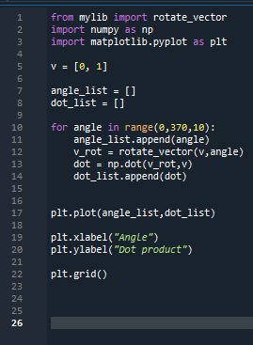
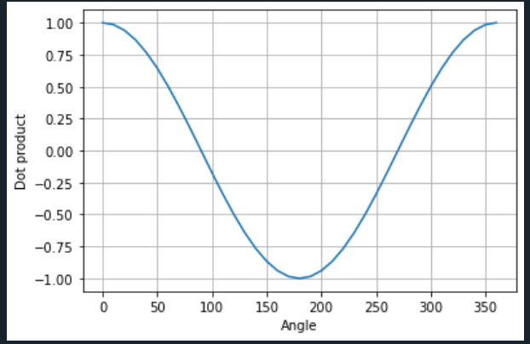
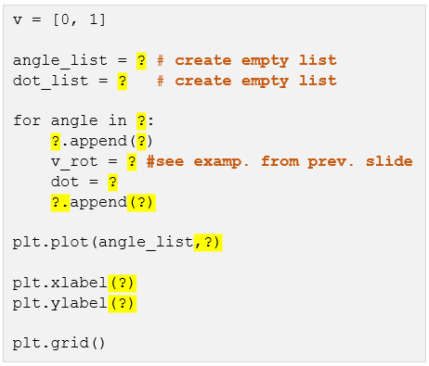
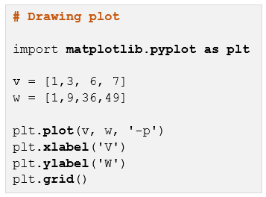
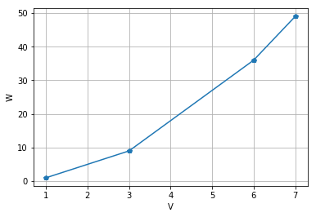
Dot Product v.s. vectors angle, cont.
“Replace” printing from previous slide with plotting.
Auxiliary examples (not solution for task)
7_list_example.py
dot
angle
8_dot_calc_angle_range_plot.py
Plot
6_plot_example.py
Notes:
1_SinewavesOrthogonality\1_DotProductOfVectors\:
- 6_plot_example.py
- 7_list_example.py
- 8_dot_calc_angle_range_plot.py

Slide 17
You are here
2D vectors
Dot product formula
Orthogonal examples
Dot product vs. angle
Vector as a list of numbers
2D example
3D example
Dot product of vectors
Dot product of signals
Sum of periodical signals
Dot product of sinusoids
Sinewaves orthogonality
Orthogonal sinewaves amplitude modulation
Discrete Fourier Transformation
Vector as a signal - signal as a vector
Dot product of signals
Signal's similarity
Dot versus phase shift
Dot versus amplitudes
Interferences

Slide 18
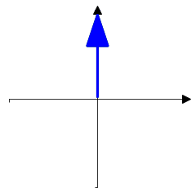
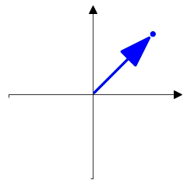














Vector as a list of numbers: 2D example
2D vector can be presented on a single axis as a list of values
y
teacher\vector_saples_view_2d.py
1
1
x
1
0.707
0
- 0.707
- 1

Slide 19

Vector as a list of numbers: 2D example, cont.
Find vectors orthogonal to vector A
cheat sheet
vector A | Orthogonal | Orthogonal | Antiparallel
4 | 1 | 7 | 6
8 | 3 | 5 | 2
Replace question marks with vector index.
Use REPL or script
teacher\aux_dot_calc_angle_range_plot.py
1
2
3
4
5
6
7
8
0.707, -0.707
1, 0
0, 1
0.707, 0.707
0, -1
-0.707, -0.707
-0.707, 0.707
-1, 0

Slide 20


Vector as a list of numbers: 3D example
Also, 3D vector can be presented on a single axis.
1.0
0.5
0.2
Teacher\vector_3d_cartesian_viev.py

Slide 21


Vector as a list of numbers: 3D example, cont.
As in case of 2D vectors a dot product allows to check
how two 3D vectors are oriented towards each other
(parallel, antiparallel, orthogonal and so on)
Unlike the 2D vector, the specified 3D vector can have
an infinite number of orthogonal vectors
Click to see how does dot product “work” for 3D vectors
3d_vect_dot.pov
3d_vect_dot_infit othog.pov

Slide 22
You are here
2D vectors
Dot product formula
Orthogonal examples
Dot product vs. angle
Vector as a list of numbers
2D example
3D example
Dot product of vectors
Dot product of signals
Sum of periodical signals
Dot product of sinusoids
Sinewaves orthogonality
Orthogonal sinewaves amplitude modulation
Discrete Fourier Transformation
Vector as a signal - signal as a vector
Dot product of signals
Signal’s similarity
Dot versus phase shift
Dot versus amplitudes
Interferences

Slide 23

Vector as a signal - signal as a vector
In fact, any list of values (scalars) can be considered a vector in a space. The dimension of space equals to values number.
Examples:
2D: (2.3, 0.4): x=2.3, y=0.4
3D: (2.3, 0.4, 12.7): x=2.3, y=0.4, z= 12.7
4D: (2.3, 0.4, 12.7, 9.2): x=2.3, y=0.4, z= 12.7, ź=9.2
ND: (2.3, 0.4, 12.7, 9.2, … , 17.3): x=2.3, y=0.4, z= 12.7, ź=9.2, … Ώ=17.3
0 , 1 , 2 , 3 , … , N <- coordinate indexes
On the other hand, any signal is a list of values, so any signal can be considered a vector in N dimensional space.
Axes
X
Y
Z
Ώ

Slide 24



Dot Product of signals
As it was said dot product let us measure how two vectors are oriented towards each other, so, dot product let us also measure relation between two signals (parallel, antiparallel, orthogonal, and so one).
A
B
One can say that dot product let us evaluate a degree of similarity between two signals.
A * B
t[s]
$$\sum_{i=0}^{10}{A[i]∗B[i]=0.4924}$$
Teacher\vector-signal_dot_plot.py
dot product ->

Slide 25




Signals similarity evaluation by using do product
Use Python to replace question marks with dot product. Use signal samples value given above the plots
Use round(x,6) when printing dot value
0.088,0.088,0.088,0.442,0.530,0.000,-0.530,-0.442,-0.088,-0.088,-0.088
0.080,0.080,0.080,0.398,0.477,0.000,-0.477,-0.398,-0.080,-0.080,-0.080
0.129,0.129,0.129,0.514,0.643,0.000,0.129,0.129,0.129,0.129,0.129
-0.129,-0.129,-0.129,-0.514,-0.643,-0.000,-0.129,-0.129,-0.129,-0.129,-0.129
-0.080,-0.080,-0.080,-0.398,-0.477,-0.000,0.477,0.398,0.080,0.080,0.080
B
A
0.899692
0.44259
-0.44259
-0.899692
A
*
B

Slide 26




Signals similarity evaluation by using do product, cont.
Please continue
0.088 0.088 0.088 0.442 0.530 0.000 -0.530 -0.442 -0.088 -0.088 -0.088
0.000 0.050 0.000 -0.050 0.000 0.050 0.000 -0.050 0.000 0.050 0.000
0.500 0.550 0.500 0.450 0.500 0.550 0.500 0.450 0.500 0.550 0.500
0.500 0.650 0.500 0.350 0.500 0.650 0.500 0.350 0.500 0.650 0.500
-0.500 -0.350 -0.500 -0.650 -0.500 -0.350 -0.500 -0.650 -0.500 -0.350 -0.500
0.0
0.0
-0.0
-0.0

Slide 27
Signals similarity evaluation by using dot product, cont.
Find analogy between signal pairs and 2D vectors pairs
Put vectors figures below proper signal figures

Slide 28
Plots customization: Example
Example of generation of vectors (1D array) with sinusoid and triangle waves
data preparation
import numpy as np
import matplotlib.pyplot as plt
from scipy import signal #required for triangle signal generation
# DATA CREATION
# definition of pi constant by using numpy library
pi = np.pi
# time vector.
# from zero to 2pi in 30 steps
t = np.linspace(0, 3*2*pi,60, endpoint=False) #
# “simple” sinusoid
sin_a = np.sin(t)
# sinusoid with amplitude equal to 2 and time shift qual to pi/4
sin_b = 2*np.sin(t+pi/4)
# triangular waveforms
#"0.5" denotes proportion between positive and negative slope
trian_a = signal.sawtooth(t,0.5)
trian_b = 2*signal.sawtooth(t+pi/2, 0.5)
trian_c = trian_a+trian_b
Notes:
1_SinewavesOrthogonality\2_PlotsCustomization\example.py

Slide 29

Plots customization: Example cont.
Simple plotting
# adding waveforms to figure
plt.plot(t,sin_a)
plt.plot(t,sin_b)
# drawing figure
plt.show()
Plots customization
# adding waveforms to figure
plt.plot(t,trian_a, 'p', label='ampl=1, phase=0', color='blue')
plt.plot(t,trian_b,'-p', label='ampl=2, phase=pi/2', color='green')
plt.plot(t,trian_c,'--', label='sum', color='brown')
# customizing figure
plt.title('Trianle waveform')
plt.xlabel('time[s]')
plt.ylabel('amplitude[a.u.]')
plt.xlim(10,20)
plt.ylim(-2,4)
plt.axhline(y=0,color='red')
plt.grid()
plt.legend()
# drawing figure
plt.show()

Slide 30



Plots customization: Exercise
Generate figure as below. Don’t forget axes titles, axes ranges and legend
Code
Plots
Notes:
1_SinewavesOrthogonality\2_PlotsCustomization\exercise.py

Slide 31
You are here
2D vectors
Dot product formula
Orthogonal examples
Dot product vs. angle
Vector as a list of numbers
2D example
3D example
Dot product of vectors
Dot product of signals
Sum of periodical signals
Dot product of sinusoids
Sinewaves orthogonality
Orthogonal sinewaves amplitude modulation
Discrete Fourier Transformation
Vector as a signal - signal as a vector
Dot product of signals
Signal’s similarity
Dot versus phase shift
Dot versus amplitudes
Interferences

Slide 32

Sum of periodic signals (same frequency)
Run script for 2 rectangular waveform and sawtooth waveform (see details in code comments)
…
from scipy import signal
…
t = np.linspace(0, 3*(2*pi),100, endpoint=False)
y_sum = np.zeros(len(t)) # sumaric vector filled with zeros
for i in range(3): # nr of components
# generating random values of phase shift and amplitude
# “rand” function generates single random nr in range from 0 to 1
phase = np.random.rand()*(2*pi)
ampl = np.random.rand()
# generating different waveforms
# select single waveform by commenting the remaining ones
y = ampl * np.sign(np.sin(t+phase)) # rectangle
#y = ampl * signal.sawtooth(t+phase,0.5) # triangle
plt.plot(t,y,'-')
y_sum = y_sum + y
plt.title('Componenets')
plt.show()
plt.title('Sum')
plt.plot(t,y_sum,'-')
plt.show()
Notes:
c:\Users\zoladz\OneDrive - Nokia\dsp_academy\Chapters_v4\1_SinewavesOrthogonality\3_SumOfPeriodicalSignals\exercise.py

Slide 33




Sum of periodic signals (same frequency), cont.
Extend the script with sinus wave generation
Put sum plots (only)
rectangle
sawtooth
Script
sinusoid

Slide 34
Sum of periodic signals (same frequency): conclusion
Which waveform type is exceptional and why ?
Rectangle seems to be exceptional as it is not similar to any of its components and its sum in fact reminds sawtooth
Sinus in turn is exceptional because its shape does not change as much as rectangle and triangle waveforms while generating many plots of each wave type in loop

Slide 35
You are here
2D vectors
Dot product formula
Orthogonal examples
Dot product vs. angle
Vector as a list of numbers
2D example
3D example
Dot product of vectors
Dot product of signals
Sum of periodical signals
Dot product of sinusoids
Sinewaves orthogonality
Orthogonal sinewaves amplitude modulation
Discrete Fourier Transformation
Vector as a signal - signal as a vector
Dot product of signals
Signal’s similarity
Dot versus phase shift
Dot versus amplitudes
Interferences

Slide 36






dot vs. phase shift
Fix and complete following script to generate plots and prints as below
Notes:
1_SinewavesOrthogonality\4_DotProductOfSinusoids\1_DotVsPahseShift.py

Slide 37























0
pi/8
pi/4
pi/3
pi/2
Use script from previous slide to put plots to generate plots for given phase shifts
np.pi/2 + np.pi/8
np.pi/2 + np.pi/4
np.pi/2 + np.pi/3
np.pi/2 + np.pi/2

Slide 38



dot vs. phase shift, cont.
Plot relationship between dot product and phase shift
Shift values should be in the range as on the plot below however,
its values do not have to be limited to values from previous slide (linspace)
Your code
Your plot
Notes:
1_SinewavesOrthogonality\4_DotProductOfSinusoids\1_DotVsPahseShift_Summary.py

Slide 39


dot vs. phase shift, cont.
Base on results from previous page
assign plots to points on “phase shift – dot value” plot

Slide 40




dot vs. phase shift, cont
Put vector figures below proper sinusoids plots

Slide 41
You are here
2D vectors
Dot product formula
Orthogonal examples
Dot product vs. angle
Vector as a list of numbers
2D example
3D example
Dot product of vectors
Dot product of signals
Sum of periodical signals
Dot product of sinusoid
Sinewaves orthogonality
Orthogonal sinewaves amplitude modulation
Discrete Fourier Transformation
Vector as a signal - signal as a vector
Dot product of signals
Signal’s similarity
Dot versus phase shift
Dot versus amplitudes
Interferences

Slide 42

dot versus amplitudes: sinus amplitude measurement
Examine dot product of two sinewaves of the same frequency and phase for time vectors of different size. Use following script to fill tables with dot product of sinusoids of selected amplitudes for two different TIME_VECTOR_SIZEs
TIME_VECTOR_SIZE=15
dot | A | 0 | 1
B | 0 | 1 | 2
0 | 0 | 0 | 0
1 | 0 | 7.5 | 15
2 | 0 | 15 | 30
TIME_VECTOR_SIZE=30
dot | AMP_A | 0 | 1
AMP_B | 0 | 1 | 2
0 | 0 | 0 | 0
1 | 0 | 15 | 30
2 | 0 | 30 | 60
Base on table content write formula illustrating relationship between
dot product value and values of A, B and TIME_VECTOR_SIZE,
dot_product(AMP_A, AMP_B, TIME_VECTOR_SIZE, )
= TIME_VECTOR_SIZE * (AMP_B*AMP_A)/2
Notes:
1_SinewavesOrthogonality\4_DotProductOfSinusoids\2_DotVsAmplitudes.py

Slide 43



dot versus amplitudes : normalization
Value of dot product of two “in-phase” sinuses depends on their: amplitudes and resolution (TIME_VECTOR_SIZE). In order to use dot product to measure amplitude of sinus one must normalize dot product, i.e., make it independent from time vector resolution
Extend previous script with “A_rx“ evaluation.
The value (not formula) of “A_rx” should:
Be equal to value of A_tx
be calculated base on dot product
should not depend on TIME_VECTOR_SIZE changes (see tables)
Expected results
B = 1 TIME_VECTOR_SIZE=15
A_tx | A_rx
0 | 0
1 | 1
2 | 2
B= 1 TIME_VECTOR_SIZE=30
A_tx | A_rx
0 | 0
1 | 1
2 | 2
2/ (TIME_VECTOR_SIZE*B);
Notes:
1_SinewavesOrthogonality\4_DotProductOfSinusoids\2_DotVsAmplitudes_Normalization.py

Slide 44


Dot product of the same frequency sinewaves: demodulation
As seen from the previous slide dot product can be used for demodulation of amplitude modulated signalas
Notes:
1_SinewavesOrthogonality\4_DotProductOfSinusoids\3_Interferencing.py

Slide 45
You are here
2D vectors
Dot product formula
Orthogonal examples
Dot product vs. angle
Vector as a list of numbers
2D example
3D example
Dot product of vectors
Dot product of signals
Sum of periodical signals
Dot product of sinusoids
Sinewaves orthogonality
Orthogonal sinewaves amplitude modulation
Discrete Fourier Transformation
Vector as a signal - signal as a vector
Dot product of signals
Signal’s similarity
Dot versus phase shift
Dot versus amplitudes
Interferences

Slide 46

Dot product of the same frequency sinewaves: Interferencing
Let's assume we have signal which is the sum of two sinusoids, carrier and interferer. Will it be possible to recover carrier amplitude the spite of interferer presence.

Slide 47



Dot product of the same frequency sinewaves: interferences, cont.
Complete script to implement given scheme.
Use the script to fill the table
Φ = pi/4
A_int = 1 |  |  | A_tx=1
A_tx | A_rx |  | A_int | A_rx
0.00 | 0.7 |  | 0.00 | 1
0.50 | 1.2 |  | 0.50 | 1.4
1.00 | 1.7 |  | 1.00 | 1.7
1.50 | 2.2 |  | 1.50 | 2.1
2.00 | 2.7 |  | 2.00 | 2.4
Φ = pi/2
A_int = 1 |  |  | A_tx=1
A_tx | A_rx |  | A_int | A_rx
0.00 | 0 |  | 0.00 | 0
0.50 | 0.5 |  | 0.50 | 1
1.00 | 1 |  | 1.00 | 1
1.50 | 1.5 |  | 1.50 | 1
2.00 | 2 |  | 2.00 | 1
Φ = pi/2 + pi/4
A_int = 1 |  |  | A_tx=1
A_tx | A_rx |  | A_int | A_rx
0.00 | -0.7 |  | 0.00 | 1
0.50 | -0.2 |  | 0.50 | 0.6
1.00 | 0.3 |  | 1.00 | 0.3
1.50 | 0.8 |  | 1.50 | -0.1
2.00 | 1.3 |  | 2.00 | -0.4
Notes:
1_SinewavesOrthogonality\4_DotProductOfSinusoids\3_Interferencing.py

Slide 48

Dot product of the same frequency sinewaves: interferences: conclusion
When do two sinewaves of the same frequency do not disturb each other?
When these two sinewaves are orthogonal as can be concluded from previous slide table
It is an exemplary case for pi/2 shifted sinewaves (i.e. sin and cos)
Assuming above condition is satisfied, is it possible to “transfer amplitude” of two sinewaves via one signal? Can we use “interferer” from previous slide as a second amplitude carier?
If yes, fulfill yellow boxes.
AmpB*cos(t)
cos(t)

Slide 49
You are here
Sinewaves orthogonality
Orthogonal sinewaves amplitude modulation
Discrete Fourier Transformation
Single frequency
Multiple frequencies
Single sinewave
Two sinewaves
Orthogonality
Modulation-Demodulation
Modulation-Demodulation
Modulation-Demodulation
2 frequencies
N frequencies
Mapping–Demapping
(Symbols)
Mapping–Demapping
(Constellations)
Single sinewave
per frequency
Two sinewaves
per frequency
Single sinewave
per frequency
Two sinewaves
per frequency

Slide 50





Single sinewave: modulation
Complete script to obtain modulated sinus as below
Do not try to obtain this lines and numbers with script They were added manually
Tx
1
2
0.5
-1
-2
Notes:
2_OrthogonalSinewavesAmplitudeModulation\1_SingleFrequency\1_SingleSineWave\1_Modulation.py

Slide 51




Single sinewave: demodulation: sinewave periods separation
Below script is expected to:
loads and plots signal saved by previous script,
Split signal to single periods,
plots periods individually.
Complete the script to obtain plots as on the right.
Notes:
2_OrthogonalSinewavesAmplitudeModulation\1_SingleFrequency\1_SingleSineWave\2_Demodulation_Step1_PeriodsSeparation.py

Slide 52





Single sinewave: demodulation: dot product and normalization
The previous script has been extended with amplitude decoding.
Complete the script to print amplitudes.
Period 0
Period 4
Notes:
2_OrthogonalSinewavesAmplitudeModulation\1_SingleFrequency\1_SingleSineWave\2_Demodulation_Step2_AmplitudeDecoding.py

Slide 53




Single sinewave: Demodulation: Dot product and normalization, cont.
This script is a modified version of the script from previous slide.
It is expected to print amplitudes in a form of single vector (list). Complete it to get result as shown below.
Your print output
Notes:
2_OrthogonalSinewavesAmplitudeModulation\1_SingleFrequency\1_SingleSineWave\2_Demodulation_Step3_AmplitudeDecodingVector.py

Slide 54


Single sinewave: Demodulation: Dot product and normalization, cont.
Use previous script to decode signal from “TxSignal_Exercise.npy” file.
Result should look as follow.
your results

Slide 55
You are here
Sinewaves orthogonality
Orthogonal sinewaves amplitude modulation
Discrete Fourier Transformation
Single frequency
Multiple frequencies
Single sinewave
Two sinewaves
Orthogonality
Modulation-Demodulation
Modulation-Demodulation
Modulation-Demodulation
2 frequencies
N frequencies
Mapping–Demapping
(Symbols)
Mapping–Demapping
(Constellations)
Single sinewave
per frequency
Two sinewaves
per frequency
Single sinewave
per frequency
Two sinewaves
per frequency

Slide 56
Mapping–Demapping : Preparations : Files
Copy following scripts
2_OrthogonalSinewavesAmplitudeModulation\1_SingleFrequency\1_SingleSineWave\1_Modulation.py
2_OrthogonalSinewavesAmplitudeModulation\1_SingleFrequency\1_SingleSineWave\2_Demodulation_Step3_AmplitudeDecodingVector.py
to directory:
2_OrthogonalSinewavesAmplitudeModulation\1_SingleFrequency\1_SingleSineWave\3_MapingDemaping
and than rename copied file:
- 1_Modulation.py -> 1_Modulate.py
2_Demodulation_Step3_AmplitudeDecodingVector.py -> 2_Demodulte.py
Recall the functionalities above scripts.
Run 1_Modulate.py and than 2_Demodulte.py.
Check whether 2_Demodulte.py prints AMPL_VECTOR from 1_Modulate.py

Slide 57




preparations : mod-demod scripts merging
Merge Modulate_1.py and Demodulate_2.py in single script 3_ModDemod.py
Remove ALL redundant code
Notes:
2_OrthogonalSinewavesAmplitudeModulation\1_SingleFrequency\1_SingleSineWave\3_MapingDemaping\3_ModDemod.py

Slide 58


preparations : code refactoring
Copy ModDemod.py to 4_ModDemod_BySingleNumber.py
At present version, the script first modulates all five numbers and after that demodulates them.
Modify 4_ModDemod_BySingleNumber.py to modulate and demodulate
per single number (reduce loops to one)
Add perfect channel between modulation and demodulation.
Decrease transmitted numbers to 4
Plot sinewave corresponding to the last number only (plt.plot(Rx) after loop)
Remove ALL redundant code
Before refactoring
script
# modulation
for … all five numbers:
…
# demodulation
for … all five numbers:
…
After refactoring
for … all five numbers:
# modulation
…
# perfect channel
Rx = Tx
# demodulation
…

Slide 59



real channel : errors
Copy 4_ModDemod_BySingleNumber.py to 5.1_ModDemod_RealChannel.py
Add normal distribution noise to channel (numpy.random.normal)
Set distribution center location at 0, deviation to 0.3 and size accordingly to Tx length
Remove redundand code
Run the script to see noise on the sine
script
Add error calculation and printing.
To do that calculate difference between send and received amplitudes
Hint: before subtraction convert list of received amplitudes to numpy array

Slide 60




real channel : noise deviation
Copy 5.1_ ModDemod_RealChannel.py to 5.2_ ModDemod_Ranges.py
Add parameter NOISE_DEVIATION to define “scale” argument of the “normal” function and set it to 1.
Increase number of transmission to 100 (single numbers)
Hint:
for i in range(TANSMISION_NR):
amp = AMPL_VECTOR[i%4]
Plot received numbers versus time for the noise deviations: 0.5 and 2 and place below
Remove redundant code (error calculation)
Script
dev=0.5
dev=1
dev=2
time

Slide 61
noise deviation, cont.
Observations
In practice, one can not transfer numbers in reliable way directly as amplitudes of sinewave.
For a given noise deviation received amplitudes values are dispersed within a certain range.
So, one sends specific values but receives values in specific range.
Unlike the number of values, the number of ranges is limited.
Question
What is the relationship between noise deviation and number of nonoverlapping ranges?
Assume ranges are distributed evenly. Give descriptive answer.
For larger noise deviation, number of nonoverlapping ranges is decreasing as I could observed in the previous slide when for dev=2 points were scattered much more than for dev=0.5

Slide 62




noise deviation vs. amplitudes symbol number
Conclusion
We can send only limited set of values (amplitudes), and the number of values in the set depends on noise deviation.
The elements of that set are called symbols.
NOISE_DEVIATION = 1
Script
Code Refactoring
Copy 5.2_ModDemodRanges.py to 5.3_ModDemodRangesColor.py
Set AMPL_VECTOR to (1, 2, 3, 4)
Modify amplitudes plot to draw each symbol with unique color. Use list indexing.
NOISE_DEVIATION=0.6
Estimation of acceptable noise dev.
Exercise
Plot
Use the script to estimate noise deviation acceptable for 8 symbols (amplitudes).
Assume we are limited to same amplitude range.

Slide 63
symbol-amplitude mapping
Symbol-amplitude mapping
Usually, symbols have a form a set of bits.
Each combination is assigned to specific amplitude (Tx) and amplitude range (Rx).
Tables on the right show examples of symbol-amplitude mapping
for 2, 4 and 8 symbol transmission schemes for constant amplitude range (c.a. 0.0-5.0)
2 symbols
symbol | Tx amplitude | Rx amplitude range
0 | 1 | 0.5 - 1.5
1 | 2 | 1.5 - 2.5
4 symbols
symbol | Tx amplitude | Rx amplitude range
00 | 0.5 | 0.25 - 0.75
01 | 1.0 | 0.75 - 1.25
10 | 1.5 | 1.25 - 1.75
11 | 2.0 | 1.75 - 2.25
To transmit specific bitstream one must divide it to groups of bits
of the size appropriate for size of the symbol .
Example
Data to transfer: byte 00100111: (lsb first)
Transmission scheme: 4 symbols
Symbol: Tx ampl. : Rx range
11: 2.0: 1.75-2.25
01: 1.0: 0.75-1.25
10: 1.5: 1.25-1.75
00: 0.5: 0.25-0.75
8 symbols
symbol | Tx amplitude | Rx amplitude range
000 | 0.25 | 0.125 - 0.375
001 | 0.50 | 0.375 - 0.625
010 | 0.75 | 0.625 – 0.875
011 | 1.00 | 0.875 – 1.125
100 | 1.25 | 1.125 – 1.375
101 | 1.50 | 1.375 – 1.625
110 | 1.75 | 1.625 – 1.875
111 | 2.00 | 1.875 – 2.125

Slide 64
symbol-amplitude mapping : exercise
Exercise
Fulfill table with symbols and amplitudes by using 8 symbol Tx scheme Data to transfer: byte 001001111110011111100111 : (lsb first)
Cheat sheet
symbol | Tx amplitude | Rx amplitude range
111 | 2.00 | 1.875 – 2.125
001 | 0.50 | 0.375 - 0.625
111 | 2.00 | 1.875 – 2.125
110 | 1.75 | 1.625 – 1.875
011 | 1.00 | 0.875 – 1.125
111 | 2.00 | 1.875 – 2.125
100 | 1.25 | 1.125 – 1.375
100 | 1.25 | 1.125 – 1.375
8 symbols
symbol | Tx amplitude | Rx amplitude range
000 | 0.25 | 0.125 - 0.375
001 | 0.50 | 0.375 - 0.625
010 | 0.75 | 0.625 – 0.875
011 | 1.00 | 0.875 – 1.125
100 | 1.25 | 1.125 – 1.375
101 | 1.50 | 1.375 – 1.625
110 | 1.75 | 1.625 – 1.875
111 | 2.00 | 1.875 – 2.125

Slide 65




Symbol-Amplitude mapping: mapping functions verification : “symbol_to_amplitude”
In the next exercises we will use readymade functions for “symbol-amplitude” mapping.
The functions make mapping between 2, 4 and 8 symbols amplitudes in range from -1 to 1.
They are collected in mapper_lib.py file so to take advantage of them you need to import them into you script.
Symbol nr = 2
Examine the content of mapper_lib.py
Below script plots mapping from symbol to amplitude for 4 symbols scheme.
Generate plots for remaining symbol numbers (put them on this slide).
Symbol nr = 4
Symbol nr = 8
Notes:
2_OrthogonalSinewavesAmplitudeModulation\1_SingleFrequency\1_SingleSineWave\3_MapingDemaping\6.1.1_Maping_SymbolToAmpl_Single.py

Slide 66




Symbol-Amplitude mapping: mapping functions verification : “symbol_to_amplitude” cont.
Complete below script to plot mapping from symbol to amplitude for transmission schemes with symbol number equals to 2, 4 and 8
Notes:
2_OrthogonalSinewavesAmplitudeModulation\1_SingleFrequency\1_SingleSineWave\3_MapingDemaping\6.1.2_Maping_SymbolToAmpl_Multiple.py

Slide 67




Symbol-Amplitude mapping: mapping functions verification : “amplitude_to_symbol”
Base one of the previous script write script for plotting mapping form amplitude to symbol.
Name the script 6.2.1_Maping_AmplToSymbol_Single.py.
Parametrize transmission scheme: “SYMBOL_NR = …” in the beginning of script.
Use the script to add missing figures.
Script
SYMBOL_NR = 2
SYMBOL_NR = 4
SYMBOL_NR = 8
Notes:
2_OrthogonalSinewavesAmplitudeModulation\1_SingleFrequency\1_SingleSineWave\3_MapingDemaping\6.2.1_Maping_AmplToSymbol_Single.py

Slide 68



Symbol-Amplitude mapping: mapping functions verification : “amplitude_to_symbol” cont.
Base one of the previous script write script to plot figure as below.
Name the script 6.2.2_Maping_AmplToSymbol_Multiple.py.
Script
Notes:
2_OrthogonalSinewavesAmplitudeModulation\1_SingleFrequency\1_SingleSineWave\3_MapingDemaping\6.2.2_Maping_AmplToSymbol_Multiple.py

Slide 69



Symbols transmission and reception
Complete below script to make given number of transmissions\receptions by using given number of symbols in the presence of given noise distribution
Typical result
Observe results while changing NOISE_DEVIATION and SYMBOL_NR
More deviation more errors, larger symbol_nr are more willing to errors
Notes:
2_OrthogonalSinewavesAmplitudeModulation\1_SingleFrequency\1_SingleSineWave\3_MapingDemaping\7.1_ModDemodSymbols.py

Slide 70




Symbols transmission and reception, error number v.s. noise deviation
Save previous script as 7.2_ModDemodSymbols_ErrorRate_vs_Noise_Print.py.
Modify it to evaluate transmission error for given range of noise deviation (see exemplary result below).
Set TRANSMISIONS_NR to 1000
Use the script to add missing results below.
Script
SYMBOL_NR = 2
SYMBOL_NR = 4
SYMBOL_NR = 8

Slide 71



Symbols transmission and reception, error number v.s. noise deviation, cont.
Save previous script as 7.3_ModDemodSymbols_ErrorRate_vs_Noise_Plot.py.
Modify it to generate plots family as on the figure below
Script

Slide 72
Symbols transmission and reception, error number v.s. noise deviation, symbol nr selection
There are methods to discover and correct errors in received data, but they work correctly below certain error rate.
If error cannot be corrected data have to be retransmitted which is quiet time and power consuming.
Error rate depends on noise level which in turn depends on many factors like: distance to base station, weather conditions, buildings, and so on.
What's important, noise level (so error rate) can change in time so in order to guarantee maximum transfer rate at current conditions one has to use symbol number appropriate for current noise level.
If symbol nr is too high for current noise level (deviation) we get many errors
and will have to make many retransmission which decrease effective transfer rate
If symbol nr is too low for current noise level (deviation) the number of errors will be low, but transfer will be also low so in practice w will be wasting possibilities given by channel.

Slide 73
Symbols transmission and reception, error number v.s. noise deviation, symbol nr selection - exercise
As it was already said, to guarantee maximum transfer rate at current conditions one has to use symbol number appropriate for current noise level.
Base on figure below estimate acceptable and optimal symbol number for given:
acceptable error number,
noise deviation.
acceptable error number = 300
noise | acceptable symbol nr(s) | optimal symbol nr
3.0 | 2 | 2
2.0 | 2,4 | 4
0.5 | 2,4,8 | 8

Slide 74
You are here
Sinewaves orthogonality
Orthogonal sinewaves amplitude modulation
Discrete Fourier Transformation
Single frequency
Multiple frequencies
Single sinewave
Two sinewaves
Orthogonality
Modulation-Demodulation
Modulation-Demodulation
Modulation-Demodulation
2 frequencies
N frequencies
Mapping–Demapping
(Symbols)
Mapping–Demapping
(Constellations)
Single sinewave
per frequency
Two sinewaves
per frequency
Single sinewave
per frequency
Two sinewaves
per frequency

Slide 75





Quadrature modulation: idea
Wy know from previous slides that it is possible to transfer two sinewaves of the same frequency via single channel (signal) if sinewaves are orthogonal. It is the case for pi/2 shifted sinewaves (sine and cosines for example)
demodulation result
modulation
Such modulation of signal is called quadrature modulation. To see why please play with bellow interactive plots.
Do not hurry - take you time.
2_OrthogonalSinewavesAmplitudeModulation\1_SingleFrequency\2_TwoSineWaves\InteractivePresentations
composition
decomposition
signal as a spinning vector
Notes:
2_OrthogonalSinewavesAmplitudeModulation\1_SingleFrequency\2_TwoSineWaves\InteractivePresentations

Slide 76
Quadrature modulation: idea
Use interactive plots from previous slide to answer following questions.
sinusoid_composition.html: find amplitude of sinus and cosinus to obtain sinusoid of amplitude 1.15 and phase 1.0 - ampl. sin: 0.97
- ampl. cos: 0.62
sinusoid_decomposition.html: find amplitude and phase of sinusoid of which is a sum of sinus of amplitude 0.5 and cosinus of amplidude 1.5
- sinusoid ampl.: 1.57
- sinusoid phase.: 1.25
sinusoid_decomposition_spinning_vector.html: what are the vector angles at which sinus and cosinus have equal value
pi/4 ; 5pi/4

Slide 77




Quadrature modulation: implementation
Complete script to implement quadrature modulation. Result should look like on the waveform below.
Tx
Notes:
2_OrthogonalSinewavesAmplitudeModulation\1_SingleFrequency\2_TwoSineWaves\1_modulation.py

Slide 78




Quadrature demodulation: implementation
Complete script to demodulate signal from previous slide
Notes:
2_OrthogonalSinewavesAmplitudeModulation\1_SingleFrequency\2_TwoSineWaves\2_demodulation.py

Slide 79


Quadrature demodulation: implementation cont.
Use previous script to decode signal from “Tx_Signal_Exercise.npy“ file.
Result should look as follow.

Slide 80
You are here
Sinewaves orthogonality
Orthogonal sinewaves amplitude modulation
Discrete Fourier Transformation
Single frequency
Multiple frequencies
Single sinewave
Two sinewaves
Orthogonality
Modulation-Demodulation
Modulation-Demodulation
Modulation-Demodulation
2 frequencies
N frequencies
Mapping–Demapping
(Symbols)
Mapping–Demapping
(Constellations)
Single sinewave
per frequency
Two sinewaves
per frequency
Single sinewave
per frequency
Two sinewaves
per frequency

Slide 81


Maping-Demaping: Preparations : copying\renaming\verifying
Copy scripts 2_AmplitudeModulation\1_SingleFrequency\2_TwoSineWaves:
1_Modulation.py
2_Demodulation.py
to: subfolder 3_MapingDemaping
Rename them as below:
1.1_Modulation.py
1.2_Demodulation.py
Run 1.1_Modulation.py and than 1.2_Demodulation.py.
Check whether 1.2_Demodulation.py prints amplitude vector from 1.1_Modulation.py

Slide 82


Maping-Demaping: Preparations : merging
Completing script on the right to Merge 1.1_Modulation.py and 1.2_Demodulation.py into single 2.1_ModDemod.py
Channel between modulation and demodulation should be ideal.
Amplitude vectors printed by the script (demodulation) should equal to amplitude vectors defined on the beginning of the script ().
Notes:
2_OrthogonalSinewavesAmplitudeModulation\1_SingleFrequency\2_TwoSineWaves\3_MapingDemaping\2.1_ModDemod.py

Slide 83



real channel : errors
Copy 2.1_ModDemod.py to 2.2_ModDemod_RealChannel.py
1. Add normal distribution noise to channel (numpy.random.normal)
Set distribution center location at 0, deviation to 2 and size accordingly to Tx length
Plot Rx corresponding to last transmitted number (plot Rx after loop)
2. Add error calculation and printing.
Script

Slide 84





Constelations
1. Copy 2.2_ModDemod_RealChannel.py to 2.3_ModDemod_RealChannel_Constelations.py
2. Add parameter NOISE_DEVIATION to define “scale” argument of the “normal” function.
3. Set amplitudes to transmit as below AMPL_VECTOR_SIN = ( 1,-1, 1,-1)
AMPL_VECTOR_COS = ( 1, 1,-1,-1)
4. Add parameter TANSMISION_NR=10 and add loop to repeat transmission TANSMISION_NR times
5. Use plt.scatter function to make plot as below. Do not forget about figure and axes titles, fixed x and y axis ranges,
and horizontal and vertical lines at x and y equal 0 (black cross in the middle)
6. Generate missing figures (see below)
Script
dev=0.5
dev=1
dev=2

Slide 85





Constelations : colors
Copy 2.3_ModDemod_RealChannel_Constelations.py to 2.4_ModDemod_RealChannel_Constelations_Colors.py
Modify script to plot each amplitude with unique color (Hint: plt.scatter(ampl_sin, ampl_cos, color=('red','orange','green','blue')[j%4]))
Generate missing figures (see below) and count errors expecteded during Rx decoding. (use plots for counting),
mark and caunt error symbols with windows screenshot tool (“shift-windows-s”)
Script
dev=1
dev=4
dev=6
errors=3
Errors = 14
errors=0

Slide 86





Constelation : transmission and reception
Complete below script to make given number of transmissions\receptions by using given number of symbols in the presence of given noise distribution. Use amplitude maping\demaping functions from mapper_lib.py.
Typical result
Notes:
2_OrthogonalSinewavesAmplitudeModulation\1_SingleFrequency\2_TwoSineWaves\3_MapingDemaping\7.1_ModDemod_Symbols.py

Slide 87




Constelation: error number v.s. noise deviation
Save previous script as 7.2_ModDemodSymbols_ErrorRate_vs_Noise_Print.py.
Modify it to evaluate transmission error for given range of noise deviation (see exemplary result below).
Set TRANSMISIONS_NR to 1000
Use the script to add complete results below.
Script
Assuming noise dev = 1.11 and acceptable error number = 300 what is an optimal symbol nr ?
: SYMBOL_NR=4

Slide 88
You are here
Sinewaves orthogonality
Orthogonal sinewaves amplitude modulation
Discrete Fourier Transformation
Single frequency
Multiple frequencies
Single sinewave
Two sinewaves
Orthogonality
Modulation-Demodulation
Modulation-Demodulation
Modulation-Demodulation
2 frequencies
N frequencies
Mapping–Demapping
(Symbols)
Mapping–Demapping
(Constellations)
Single sinewave
per frequency
Two sinewaves
per frequency
Single sinewave
per frequency
Two sinewaves
per frequency

Slide 89
Orthogonal frequencies: Introduction
Summary
In the last exercise we made data transmission we used two orthogonal sinewaves of the same frequency.
Amount of transmitted data was proportional to number of time slots (two number per slot, one for cosines second for sinus).
One time slot corresponded to single period of sinewave.
Observation
Above transition scheme based on observation that if two same frequency sinewaves are shifted of pi/2 they are orthogonal and in practice they do not interfere when placed in a single signal.
Motivation
To send more data via the same signal (channel)
Hypothesis
It I possible to transfer two or more sinewaves of different frequency via single signal in the way that hey do not interfere.
Experiments
Let’s examinate orthogonality (dot product) of sinewaves of different frequencies

Slide 90

Frequencies orthogonality : sinus
Use interactive presentation to find frequencies orthogonal to sin(1*t). (Fill the table)
Blue frequency = 1.0
Green frequency at which dot_product(blue, green)==0
0.5: 0
1: 15.5
1.5: 0
2.0: 0
2.5: 0
3.0: 0
Notes:
2_OrthogonalSinewavesAmplitudeModulation\2_MultipleFrequencies\1_Orthogonality\InterActive\dot_produc_of_two_sinuses.html

Slide 91


Frequencies orthogonality : cosinus
Do the same for cosines
Blue frequency = 1.0
Green frequency at which dot_product(blue, green)==0
0.5: 0
1: 15.5
1.5: 0
2.0: 0
2.5: 0
3.0: 0
Notes:
2_OrthogonalSinewavesAmplitudeModulation\2_MultipleFrequencies\1_Orthogonality\InterActive\dot_produc_of_two_cosinuses.html

Slide 92



Orthogonal frequencies: estimation for sine waves, scripting
1. Complete script to plot relationship between frequency ratio of two sinusoids and dot product.
Refence plot
2. Mark orthogonal frequencies on x axis of the plot
Do it manually in PowerPoint by drawing red vertical lines on the plot
Notes:
2_OrthogonalSinewavesAmplitudeModulation\2_MultipleFrequencies\1_Orthogonality\dot_product_vs_frequency.py

Slide 93
You are here
Sinewaves orthogonality
Orthogonal sinewaves amplitude modulation
Discrete Fourier Transformation
Single frequency
Multiple frequencies
Single sinewave
Two sinewaves
Orthogonality
Modulation-Demodulation
Modulation-Demodulation
Modulation-Demodulation
2 frequencies
N frequencies
Mapping–Demapping
(Symbols)
Mapping–Demapping
(Constellations)
Single sinewave
per frequency
Two sinewaves
per frequency
Single sinewave
per frequency
Two sinewaves
per frequency

Slide 94




Two frequencies : Single sinewave per frequency : modulation
Complete script to obtain Tx signal composed of two modulated sinusoids of orthogonal frequencies
Tx
Notes:
_OrthogonalSinewavesAmplitudeModulation\2_MultipleFrequencies\2_Modulation-Demodulation\1_2Carriers\1_SingleSinevawePerFrequency\1_Modulation.py

Slide 95



Two frequencies : Single sinewave per frequency : Demodulation
Complete script to decode amplitudes of sinusoids from Rx signal
Notes:
_OrthogonalSinewavesAmplitudeModulation\2_MultipleFrequencies\2_Modulation-Demodulation\1_2Carriers\1_SingleSinevawePerFrequency\2_DeModulation.py

Slide 96
You are here
Sinewaves orthogonality
Orthogonal sinewaves amplitude modulation
Discrete Fourier Transformation
Single frequency
Multiple frequencies
Single sinewave
Two sinewaves
Orthogonality
Modulation-Demodulation
Modulation-Demodulation
Modulation-Demodulation
2 frequencies
N frequencies
Mapping–Demapping
(Symbols)
Mapping–Demapping
(Constellations)
Single sinewave
per frequency
Two sinewaves
per frequency
Single sinewave
per frequency
Two sinewaves
per frequency

Slide 97




Two frequencies : Two sinewaves per frequency : Modulation
Complete script to make quadrature modulation of two orthogonal frequencies, i.e. 1 and 2
Notes:
2_OrthogonalSinewavesAmplitudeModulation\2_MultipleFrequencies\2_Modulation-Demodulation\1_2Carriers\2_TwoSinevawesPerFrequency\1_Modulation.py

Slide 98



Two frequencies : Two sinewaves per frequency : Demodulation
Complete script to demodulate signal which consists of two orthogonal quadrature modulated frequencies
Notes:
2_OrthogonalSinewavesAmplitudeModulation\2_MultipleFrequencies\2_Modulation-Demodulation\1_2Carriers\2_TwoSinevawesPerFrequency\1_DeModulation.py

Slide 99
You are here
Sinewaves orthogonality
Orthogonal sinewaves amplitude modulation
Discrete Fourier Transformation
Single frequency
Multiple frequencies
Single sinewave
Two sinewaves
Orthogonality
Modulation-Demodulation
Modulation-Demodulation
Modulation-Demodulation
2 frequencies
N frequencies
Mapping–Demapping
(Symbols)
Mapping–Demapping
(Constellations)
Single sinewave
per frequency
Two sinewaves
per frequency
Single sinewave
per frequency
Two sinewaves
per frequency

Slide 100




N frequencies : Single sinewave per frequency : Modulation
Complete script to obtain Tx signal composed of N amplitude modulated sinusoids of orthogonal frequencies
Notes:
2_OrthogonalSinewavesAmplitudeModulation\2_MultipleFrequencies\2_Modulation-Demodulation\2_NCarriers\1_SingleSinevawePerFrequency\1_Modulation.py

Slide 101



N frequencies : Single sinewave per frequency : Demodulation
Complete script to demodulate signal which consists of N amplitude modulated sinusoids of orthogonal frequencies
Notes:
2_OrthogonalSinewavesAmplitudeModulation\2_MultipleFrequencies\2_Modulation-Demodulation\2_NCarriers\1_SingleSinevawePerFrequency\1_DeModulation.py

Slide 102
You are here
Sinewaves orthogonality
Orthogonal sinewaves amplitude modulation
Discrete Fourier Transformation
Single frequency
Multiple frequencies
Single sinewave
Two sinewaves
Orthogonality
Modulation-Demodulation
Modulation-Demodulation
Modulation-Demodulation
2 frequencies
N frequencies
Mapping–Demapping
(Symbols)
Mapping–Demapping
(Constellations)
Single sinewave
per frequency
Two sinewaves
per frequency
Single sinewave
per frequency
Two sinewaves
per frequency

Slide 103



N frequencies : Two sinewaves per frequency : Modulation
Complete script to make quadrature modulation of N orthogonal frequencies
Tx
Notes:
2_OrthogonalSinewavesAmplitudeModulation\2_MultipleFrequencies\2_Modulation-Demodulation\2_NCarriers\2_TwoSinevawesPerFrequency\1_Modulation.py

Slide 104


N frequencies : Two sinewaves per frequency : Demodulation
Complete script to demodulate signal which consists of N quadrature modulated frequencies
Notes:
2_OrthogonalSinewavesAmplitudeModulation\2_MultipleFrequencies\2_Modulation-Demodulation\2_NCarriers\2_TwoSinevawesPerFrequency\2_DeModulation.py

Slide 105
You are here
Sinewaves orthogonality
Orthogonal sinewaves amplitude modulation - DONE
Discrete Fourier Transformation
Single frequency
Multiple frequencies
Single sinewave
Two sinewaves
Orthogonality
Modulation-Demodulation
Modulation-Demodulation
Modulation-Demodulation
2 frequencies
N frequencies
Mapping–Demapping
(Symbols)
Mapping–Demapping
(Constellations)
Single sinewave
per frequency
Two sinewaves
per frequency
Single sinewave
per frequency
Two sinewaves
per frequency

Slide 106

Discrete Fourier Transformation by Jack Schaedler
Sinewaves orthogonality
Orthogonal sinewaves amplitude modulation
Discrete Fourier Transformation (DFT)
Familiar with below web page up to and including chapter “Digging deeper”.
https://jackschaedler.github.io/circles-sines-signals/index.html
(It is the best introduction to DFT known to tutor. It should take 3h)

Slide 107



DFT, Aliazing (ambiguity)
Complete script to obtain given plot.
Notes:
3_DiscreteFourierTransformation\1_aliazing_student.py

Slide 108







DFT, Aliazing cont
Use the script to complete missing plots

Slide 109


DFT Aliazing cont
Copy all plots from previous slide to this slide but
put the plots in lower row below similar (or “antisimilar”) plots from upper row.
Which frequency is “axis of symmetry” ?
What is relation between it and sampling frequency?
Which sine is similar to sin(freq=3)?
Which sine is similar to sin(freq=3)? → freq=7
Which frequency is “axis of symmetry”? → freq=5
What is relation between it and sampling frequency? → 2*freq = sample_rate

Slide 110





DFT, input
Use given script to complete plots
Move function “my_stem_plot” to library “mylib” and make script to run again
“f” is a “SIN_FREQ” parameter from script
f=2
f=3
f=4
Notes:
3_DiscreteFourierTransformation\2_my_stem_plot_intro.py

Slide 111






DFT, NumPy implementation (FFT)
Complete script to get given plot set:
import “my_stem_plot”
modify “my_stem_plot” to get plots figures in the shape of square
Reference plots
Your plots
Notes:
3_DiscreteFourierTransformation\3_numpy_dft.py

Slide 112







DFT, numpy implementation (FFT)
Complete given plot set
f=1
f=2
f=4
f=6
f=7
f=8
f=9

Slide 113









DFT: real component
Repeat previous slide for cosine
Put plots here

Slide 114








DFT, amplitude
Generate plot set from previous slide for sinus and csinus f=3 and signal amplitudes: 1, 4/5, 2/5, 1/5
Base on plots analizys write formula for DFT amplitude:
RealAmp(cos_amp,sample_nr) = (sample_nr/2) * cos_amp
ImagAmpl(sin_amp,sample_nr) = (sample_nr/2) * sin_amp
Put plots here

Slide 115



DFT, amplitude cont.
Find formula for signal which gives presented DFT
Place on the slide corresponding samples plot
Put “Samples” plot
here

Slide 116



Your DFT
Complete the part of the script evaluating real part of DFT.
(Recall from previous chapters how to measure amplitude of sinus or cosinus in signal)
Check completed script for various cosinus frequencies
Plots for SIN_FREQ =3 should look as following
Notes:
3_DiscreteFourierTransformation\4_mine_dft.py

Slide 117


Your DFT cont
Complete previous script with evaluation of imaginary part
Encapsulate DFT related code into “myDFT” function which should:
- receive ne argument (samples)
- not use SAMPLE_NUMER const.
- use ne loop only
- “return real, image”
3. Move the function to mylib and make the main script work
function and main script
Notes:
3_DiscreteFourierTransformation\4_mine_dft.py

Slide 118






Your DFT
Check myDFT by using following script. It should generate plots as below.
samples
FFT real
myDFT real
FFT imag
myDFT imag
Notes:
3_DiscreteFourierTransformation\5_mine_dft_test.py

Slide 119



“myDFT–numpy DFT” comparison by using DTFM signal
Use following script for “myDFT–numpy DFT” comparison by using exemplary DTFM signal. (Read comments carefully)
plots
https://www.audiocheck.net/audiocheck_dtmf.php
Notes:
3_DiscreteFourierTransformation\6_dtfm.py

Slide 120




Decoding DTFM signal by using DFT
Use following script from previous slide to decode following samples of DTFM signal (see Wikipedia).
Replace question mark with key.
a.wav: 7
b.wav: 5
c.wav: 3
d.wav: #
plots
Notes:
wav/*.wav

